Slide 1








Proudly supported by our partners:
PLATINUM
GOLD
SILVER
GLOBAL

Slide 2

Kerberos Authentication & SQL Server
A Deep Dive into Delegation

Slide 3

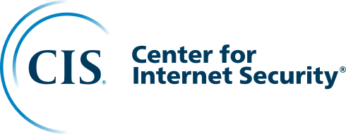



Introduction
Danny de Haan
Solutions Engineer
thatinfradba.com | thatinfradba@pm.me | /dannydh | /ThatInfraDba

Slide 4
Agenda
Kerberos in Active Directory
Service Principal Names
Database Engine
Delegation
SSRS / PBIRS
Troubleshooting Tips
Attack Scenarios

Slide 5
Kerberos in Active Directory

Slide 6

Something with tickets?

Slide 7

Why Kerberos?
KDC
Client
Service (SQL)

Slide 8
Authentication Service
KDC
Client
I want to authenticate
Identity Check
TGT
Here is your ticket
TGT

Slide 9
Authentication Service (KDC)
KRB_AS_REQ
KRB_AS_REP
user@domain.local
Timestamp
TGT
User@domain.local
IP Address
Validity
PAC
User | Hash
Anna | <Anna’s hash>
Chris | <Chris’ hash>
... | ...
User | <User’s hash>
... | ...

Slide 10
Ticket-Granting Service
KDC
Client
TGT
I want to use Service (SQL)
Service Check
TGS
Here is your ticket
TGS

Slide 11
Ticket-Granting Service (tickets)
KRB_TGS_REQ
KRB_TGS_REP
Authenticator
user@domain.local
Timestamp
TGT
SQL/SERV01

Slide 12
Ticket-Granting Service (KDC)
TGT
user@domain.local
IP Address
Validity
PAC
TGT
user@domain.local
IP Address
Validity
PAC
Authenticator
Authenticator
user@domain.local
Timestamp
user@domain.local
Timestamp
Valid?

Slide 13
Ticket-Granting Service (tickets)
KRB_TGS_REQ
KRB_TGS_REP
Authenticator
TGS
user@domain.local
Timestamp
SQL/SERV01
user@domain.local
Timestamp
PAC
TGT
SQL/SERV01

Slide 14
Ticket-Granting Service (Client)
TGS
TGS
SQL/SERV01
SQL/SERV01
user@domain.local
Timestamp
PAC
user@domain.local
Timestamp
PAC

Slide 15
Application Request
Client
Service (SQL)
TGT
TGS
I want to use your service
Ticket verification
You are granted access

Slide 16

Application Request (Service)
KRB_AP_REQ
KRB_AP_REP
Authenticator
user@domain.local
Timestamp
TGS
Authenticator
user@domain.local
Timestamp
TGS

Slide 17
Service Principal Names

Slide 18
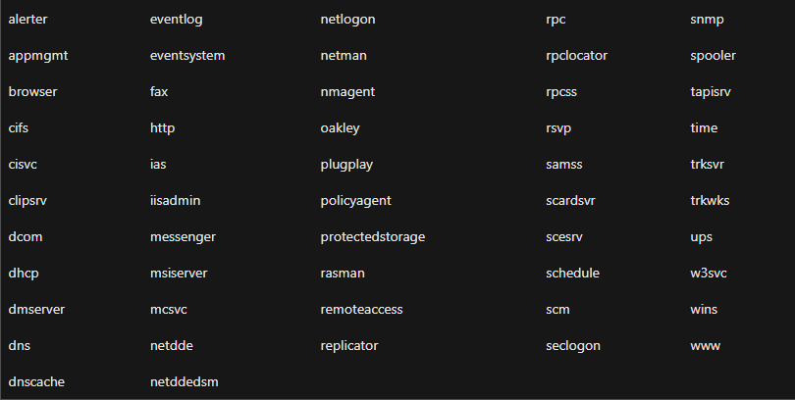
Service Principal Names
What is a Service?
SPN Definition
Service Class
SQL Server
service_class/host(:port)
MSSQLSvc
MSSQLSvc/Server01:1433

Slide 19
Commands
SETSPN
  setspn -l (list)
  setspn -s (create)
  setspn -d (remove)

Slide 20
Database Engine

Slide 21
Database Engine Demo
Setup:
Domain Controller (purpledc)
SQL Server Host (purplesql01)
Admin Server (purpleadm)
DEMO

Slide 22
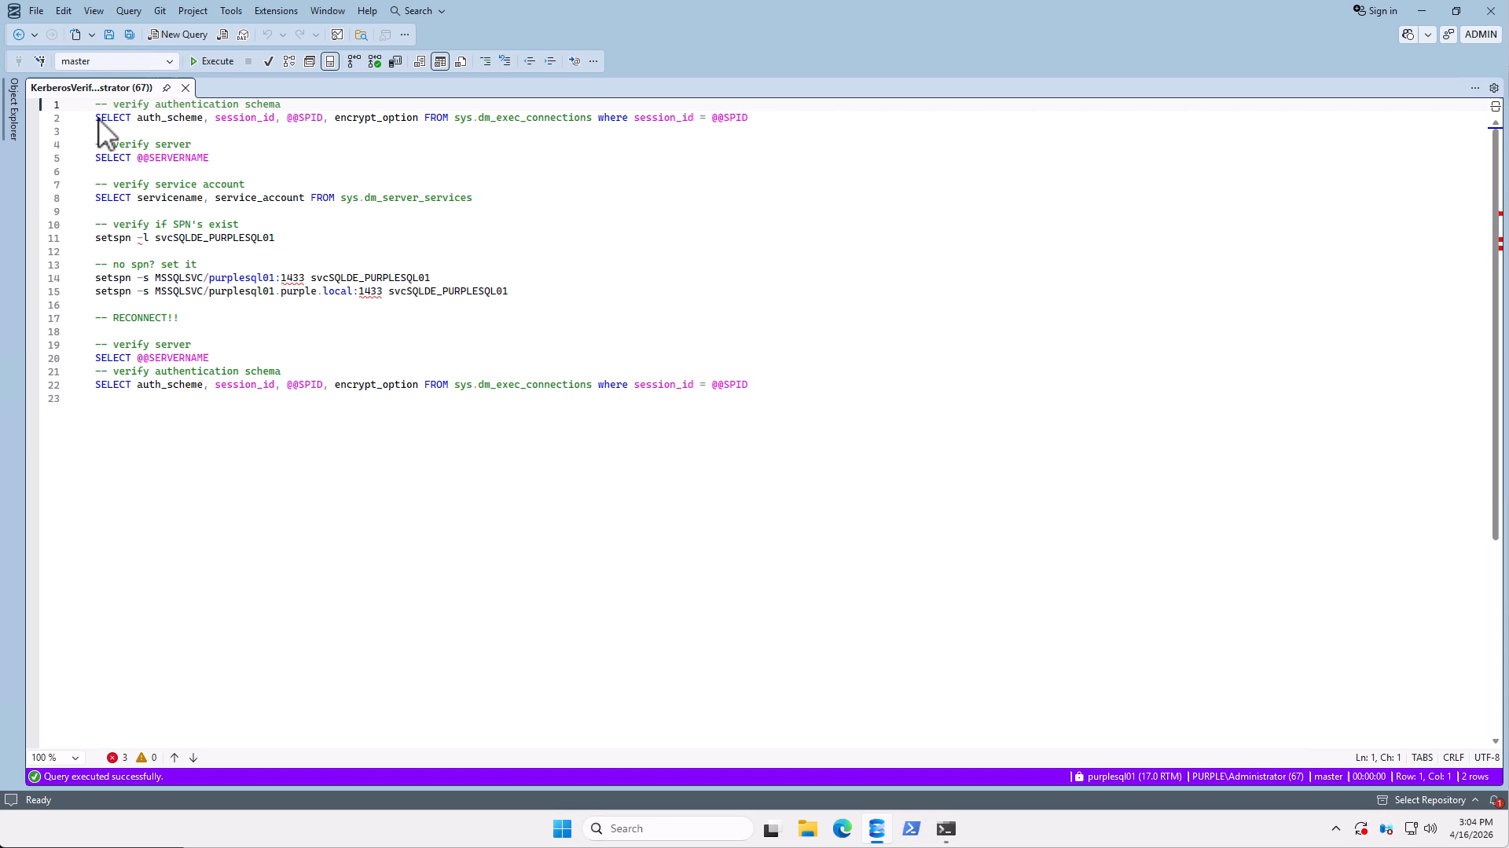
Demo video

Slide 23
Delegation

Slide 24
Delegation
What is delegation?

Slide 25
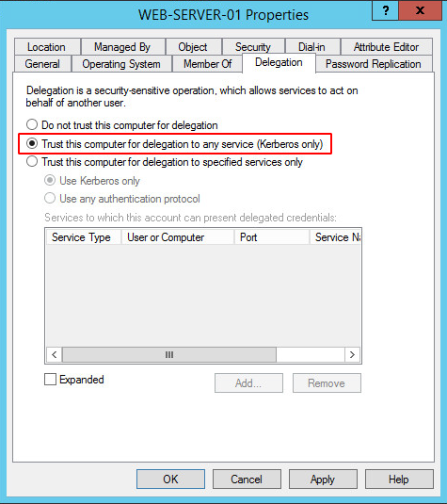


Unconstrained Delegation

Slide 26
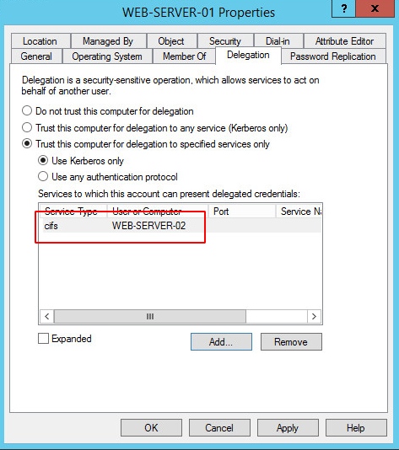
Constrained Delegation
Constrained Delegation:
CIFS/WEB-SERVER-02

Slide 27
Resource Based Constrained Delegation
Responsibility lies with the Back-end Service
Inter-Domain delegation
Can be configured using PowerShell or Extended Attributes
New-ADComputer
New-ADServiceAccount
New-ADUser
Set-ADComputer
Set-ADServiceAccount
Set-ADUser
PrincipalsAllowedToDelegateToAccount

Slide 28
Resource Based Constrained Delegation
User
1. Send TGS
DC
Server01$
Server02$
SERVER01$ in
msDS-AllowedToActOnBehalfOfOtherIdentity
of Resource B
2. TGS Request for
Resource B
4. Send TGS
Service A
Resource B
3. Request denied
3. TGS for Resource B as USER

Slide 29
Delegation Weaknesses
Unconstrained delegation: A compromised service has the user’s full TGT and can impersonate them to anything.
Constrained delegation with protocol transition: S4U2Self lets the service request a ticket "as if" any user authenticated (including Domain Admins) without the user ever connecting. Combined with S4U2Proxy, a compromised service account can impersonate anyone to its allowed target services.
Resource-based Constraint Delegation: Anyone with write access to a computer's AD object can add a trusted account to msDS-AllowedToActOnBehalfOfOtherIdentity - no Domain Admin needed. Combined with the default machine account quota (any user can create up to 10), an attacker can build an entire delegation trust from scratch.

Slide 30
SSRS/PBIRS

Slide 31
SSRS / PBIRS
WinRM uses HTTP Service Class on machine name
SPN on different A-record for Reporting Services
Constrained Delegation to HTTP SPN
Constrained Delegation to SPN of Data Source (MSSQLSvc)

Slide 32
Reporting Services Demo
Setup:
Domain Controller (purpledc)
SQL Server Host (purplesql01)
PBIRS (purplers01 on purplesql01)
SQL Server Host (purplesql02)
Admin Server (purpleadm)
DEMO

Slide 33
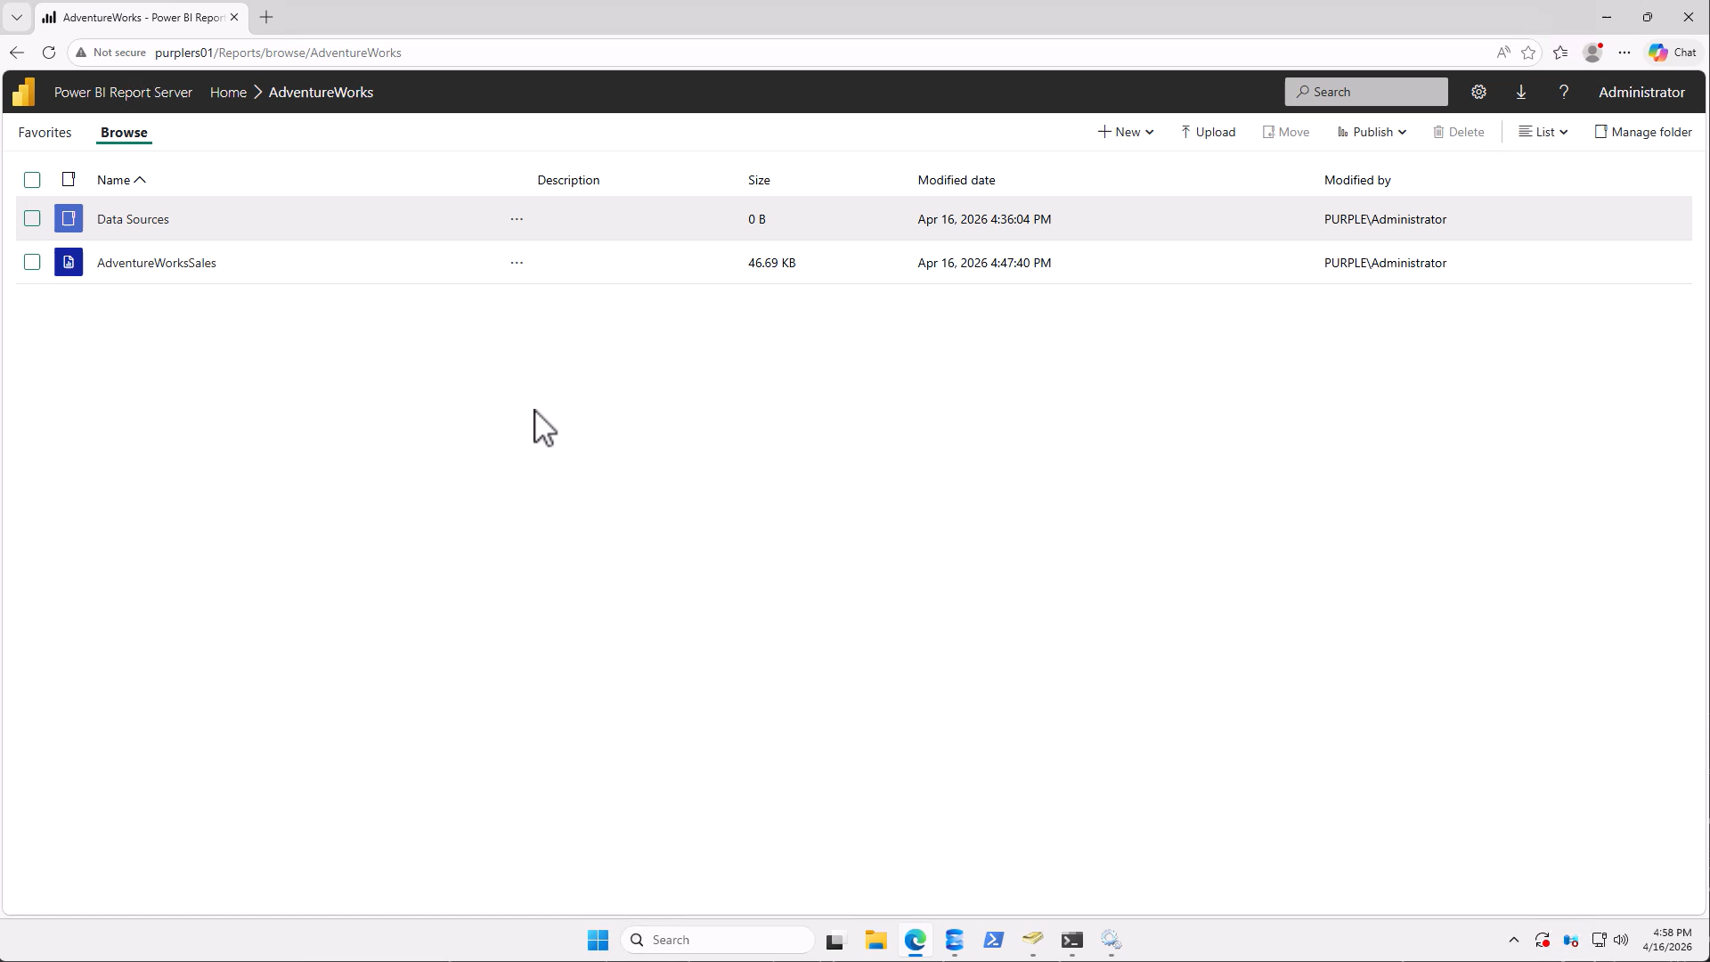
Demo video

Slide 34
Troubleshooting Tips

Slide 35
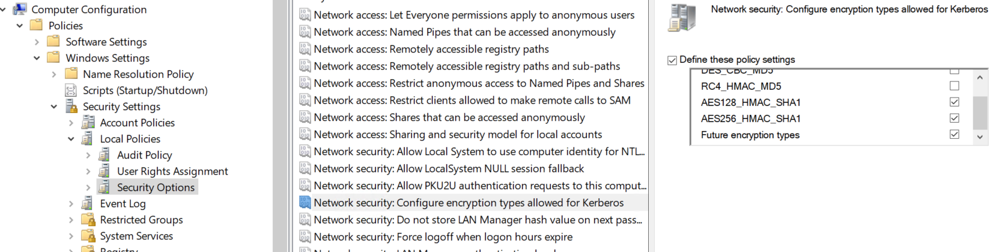
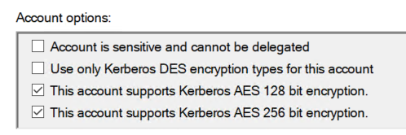
Ciphers
Network Security Settings (Network security: Configure encryption types allowed for Kerberos)
DES | AES 128/256 settings on accounts

Slide 36
Troubleshooting Tips
Verify SPN’s
Verify delegation settings
Microsoft Kerberos Configuration Manager / SQLCHECK
Ensure the account can be delegated
https://learn.microsoft.com/en-us/troubleshoot/sql/database-engine/connect/resolve-connectivity-errors-checklist

Slide 37
Attack Scenario’s

Slide 38
Attack Scenarios
Pass the Hash
Pass the Ticket
Kerberoasting
Silver / Golden Tickets

Slide 39
Silver Ticket
TGS
2. TGS forging
SQL/SERV01
user@domain.local
Timestamp
PAC
Attacker
1. Service Account NT Hash
DESKTOP-01
domain.local
MSSQLSvc/desktop01:1433
domAdmin
2099/01/01 00:00:00
PAC (Domain Admin)
3. Authenticate to targeted service

Slide 40
Golden Ticket
2. TGT forging
Attacker
1. krbtgt NT Hash
KDC
domain.local
domAdmin
2099/01/01 00:00:00
PAC (Domain Admin)
3. Ask for any TGS

Slide 41
How to protect?
Encryption ciphers (only AES128/128/future ciphers)
Use gMSA for SQL Service Accounts
Enable Credential Guard
Monitor event IDs 4769 and 4770 in AD
Honey pots (weak account security)

Slide 42
Lessons Learned
Kerberos phases
Service Principal Names
Delegation
How to set up SQL Server & Reporting Services
Troubleshooting tips
Attack scenario’s

Slide 43
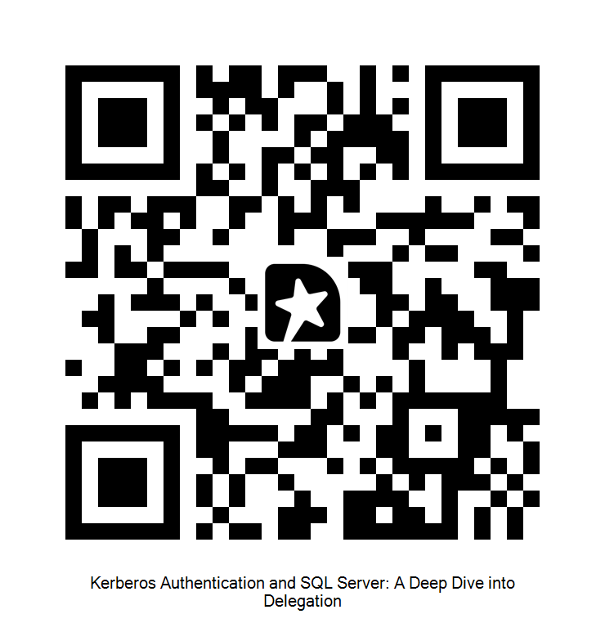
Thank you very much
Danny de Haan
thatinfradba.com | thatinfradba@pm.me | /dannydh

Slide 44
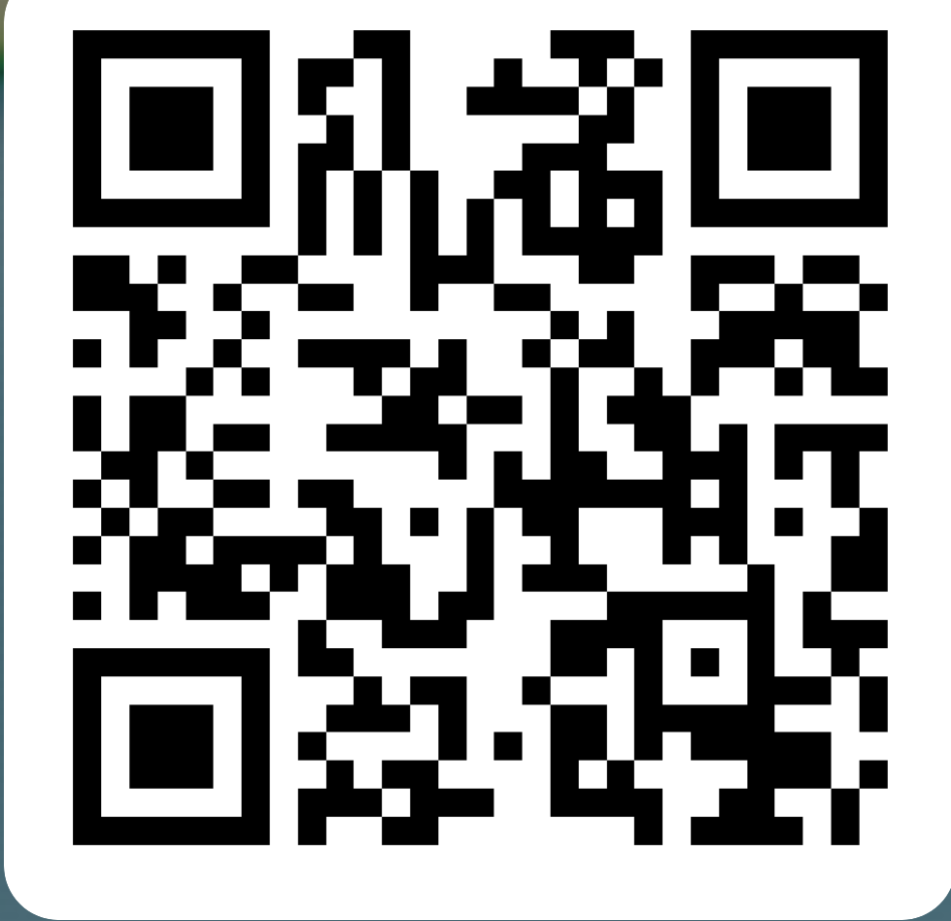
Feedback = appreciated!
Proudly supported by our partners:
PLATINUM
GOLD
SeaQL event feedback:
SILVER
GLOBAL
https://forms.office.com/e/r5CV3yVSKQ

